Slide 1


Monitoring Performance Of the Labour’s and their Productivity In Their Work Area By Using Various IOT-Sensors

Slide 2

Project Leadership
Sharat Manikonda
Director at Innodatatics and Sponsor
linkedin.com/in/sharat-chandra

Slide 3


Contents
Introduction
Project Goals
CRISP-ML(Q) Methodology
Technical Stacks
Project Architecture
Data Collection & Understanding
Data Information
Exploratory Data Analysis [EDA]
Data Visualization
Model Building
Model Deployment
Screen shot of output
Challenges
Future Scopes
IOT-Sensors Prices
Notes:
Change

Slide 4
Project Overview and Scope
Using IOT Sensors to Track and Monitor the Performance of Labour’s and their Work efficiency at Project Site to know who is Working Good and Who is Skipping Away from their Work

Slide 5
Project Goals
The Goal is to identify the productivity of Labour’s by tracking their Activities On the Site With The Help of Motion Sensor To know the performance
Business Objective : Maximize the Productivity of their Labours by keep tracking them in work areas by using IOT sensors Like Motion Sensor
Business Constraints : Minimizing the wastage of time of Labour’s during the work time like Chatting , Roaming here and their , Drinking Tea, Juice, Water. Etc.

Slide 6
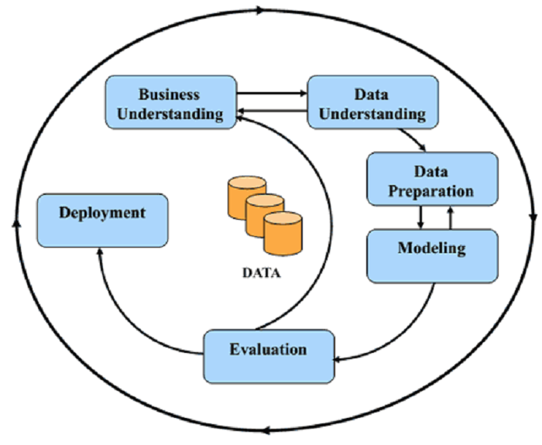
CRISP-ML(Q) Methodology

Slide 7











Technical Stacks
Python: a tool used for Data manipulations and modelling
Spyder : a tool used for Data Modelling
Python Flask : Used for web Framework & to Deploy our Model
HTML : For Frontend Webpage
GitHub: Used for Data Storage
Notes:
Pycharm add Tableau

Slide 8


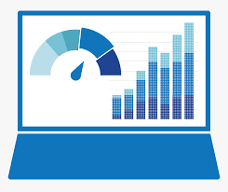

Project Architecture
Exploratory data analysis
Partition the Data Into
X = Predictors
Y = Target
Data collection
Data is collected by doing
Research on Google on EmeraldInsights.com.
Data extraction
Data Visualization
Data Preprocessing
Column Transformer
Column Transformer Pipeline
1. Simple Imputer
2. Winsorization
3. MinMaxScaling
4. OneHotEncoding
Model Deployment
Classification models
1.Decision Tree Classifier and Grid Search CV
2.KNN Classifier
3.Logistic Regression
4. Support Vector Classifier
5.Random forest Classifier
Splitting data into train and test
Model
Evaluation
Model building
Hyper
parameter
tuning

Slide 9

Data collection and information
We got the data from primary resources as well as www.Emerald.com
I have preprocessed the collected data by performing few modifications and later I built model.
I collected features based on research and sensors datasets.

Slide 10


Data Information
Data is having various features. The shape of dataset is
276 rows and 25 columns. Out of them, 14 numeric and
11 categorical columns.
In this dataset, I already have IOT- sensors features like, Rfid,
Noise Detection , Infrared Sensor, Gas Sensor,
Galvanic Skin Response Sensor, Skin Temperature sensor,
Blood Volume Pulse, Respiration Rate Sensor, Heart Rate Sensor,
Motion Sensor.
Target variable is performance and is in Binary 0,1
Like Productive and Non-Productive.

Slide 11
Data Dictionary
Features | Description
Emp ID | Labour Identification number
Name | Name of the Labour
Age | Age of the Labour
Gender | Gender of the Labour
Nationality | Nationality of the Labour to nation he or she Belongs like japan, china, Malaysia , Bangladesh , Philippines, Pakistan, Sri Lanka
Martial Status | Martial Status of the Labour like Married , Unmarried, Divorced
Designation | The Designation of the Labour depends on he or she is Skilled , Un-skilled, or Semi-Skilled
Experience | The Experience of the Labour means how many Years of the experience do have to particular Labour related to the construction Field

Slide 12
Features | Description
Work Date | Actual Working Date of the Labour
Site | The Working Site of labour like where he is working at Site1, Site 2 , Site 3
Rfid | The Radio Frequency Identification reader is Network-connected device attached to labour’s
Latitude | The latitude Shows The Working position of Labour’s like The angular distance north or south of the equator on any meridian
Longitude | The latitude Shows The Working position of Labour’s like The angular distance East or West of the equator on any meridian
Work Started Time | Actual Work Started Time of the Labour
Body Temperature | Actual Body Temperature of the Labour
Noise Detection | The Noise Detection at Site like Site 1 , Site 2 , Site 3
Infrared Sensor | The Infrared Sensor Tells whether the labour is present or absent

Slide 13
Features | Description
Gas Sensor | The Gas Sensor Detects the Dangerous Gases in air on Project Site 1, Site 2 , Site 3 Which are Harmful to labour’s
Galvanic Skin Response Sensor | The Galvanic Skin Response Sensor Tells Stress Level of the Labour More the Reading less the Stress and Less the Reading More the Stress Level
Skin Temperature Sensor | Skin Temperature Sensor specifically used for continuous temperature monitoring using the skin as an indicator of body temperature
Blood Volume Pulse | The BVP measures heart rate based on the volume of blood that passes Through the tissues in a localized area will each beat (pulse) of the heart.
Respiration Rate Sensor | The Respiration Rate Sensor Measure The Breathing Taken per Minute By the Labour Working on Site
Heart Rate Sensor | The Heart Rate Sensor tells heart Rate of Labour Working on Site
Motion Sensor | The Motion Sensor sense Motions of labour like Moving Bricks , Welding, Cutting Bricks, Fetching Mortar, etc.
Performance | The Performance column is our Target Variable to know the Labour is doing Productive Work or Non-Productive based on Motion Sensor

Slide 14

System Requirements
System Requirements
Memory: 4GB RAM
CPU: Intel Core i3 8th Gen
OS: Windows 10
Prepare Environment
Install python version 3.9
Install Anaconda software to launch IDE platform like Spyder
Creating a new Environment
Install Pandas for preprocessing of data
Install NumPy for mathematical calculations
Install sklearn
Used Python flask for web-frame work & Model - Deployment

Slide 15
EDA Description
Treating missing values in data with Simple Imputer
No Duplicate rows were Present in the Data Set
The Outliers Treatment Using Winsorization Capping Method

Slide 16
Missing Values Observation
Missing values means N/A values or NAN values.
If there is any data missing from data set or if any row observed as blank then it is called as missing values
There are missing values observed in my dataset.
So I did Simple imputer mean imputation

Slide 17
PipeLine
Simple Imputer
Winsorization
MinMaxScaling
OneHotEncoding

Slide 18


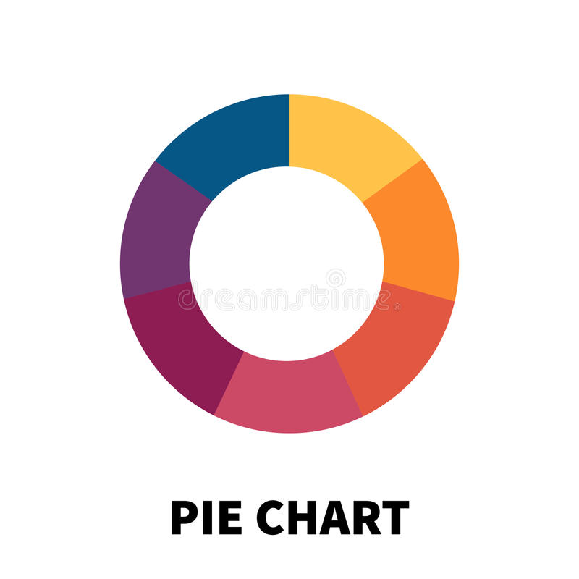
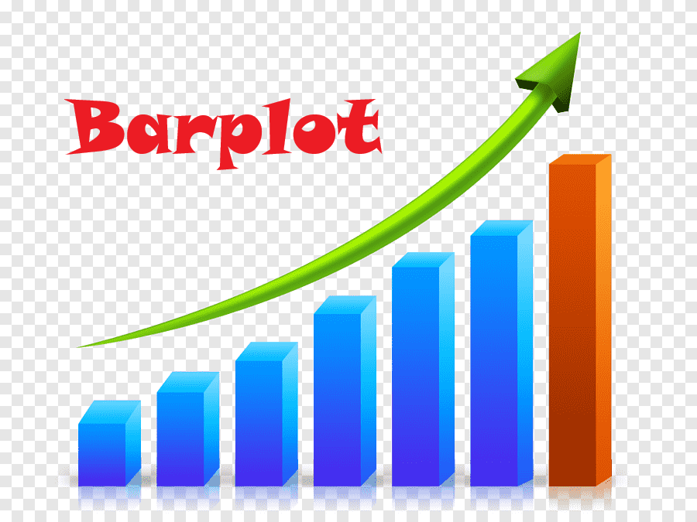

Data Visualization
Some of the tools are used to visualize the data
Notes:
Keep observations

Slide 19
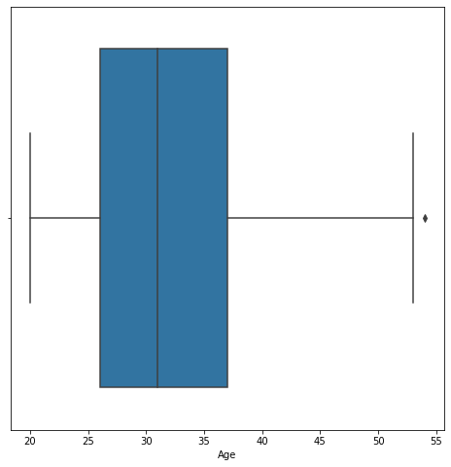
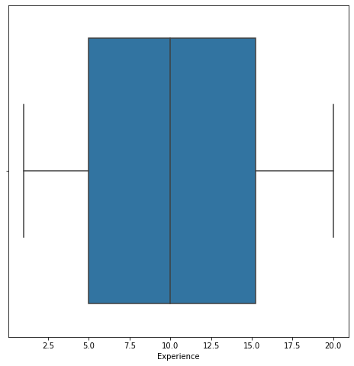
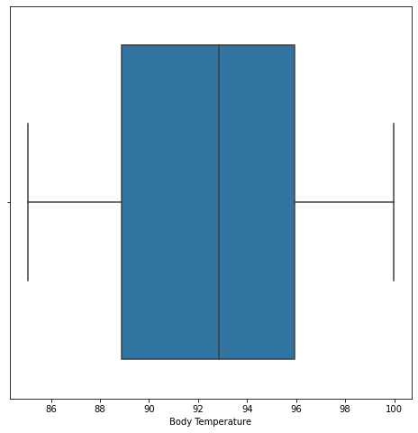
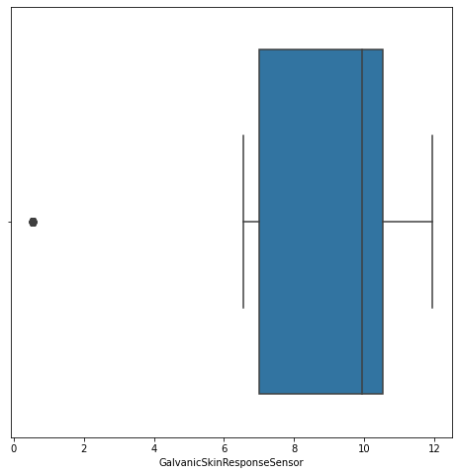
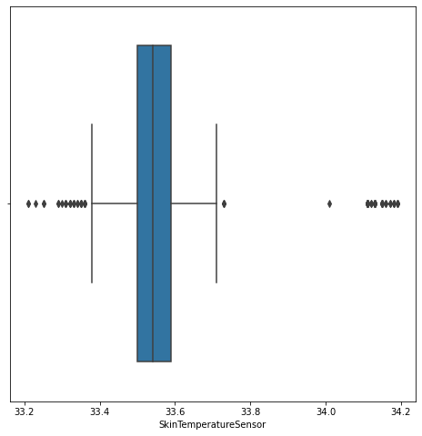
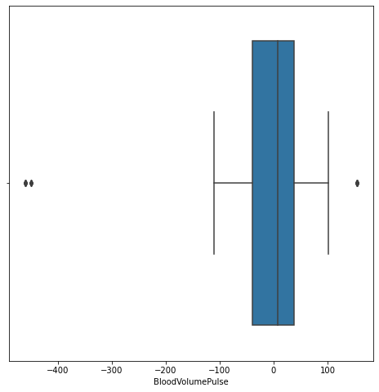
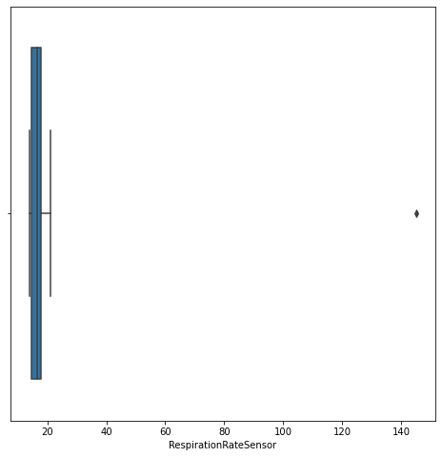
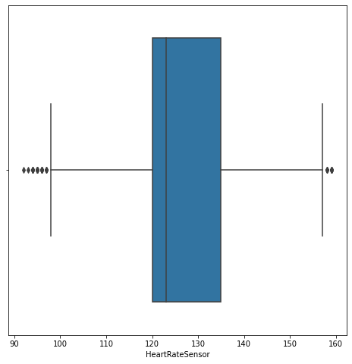
Data Visualization
Notes:
Add graphical

Slide 20
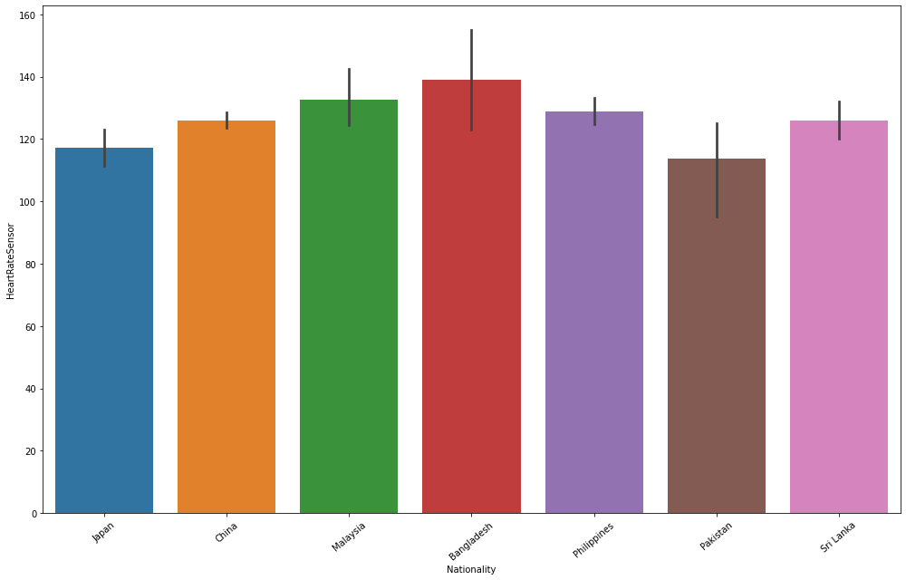
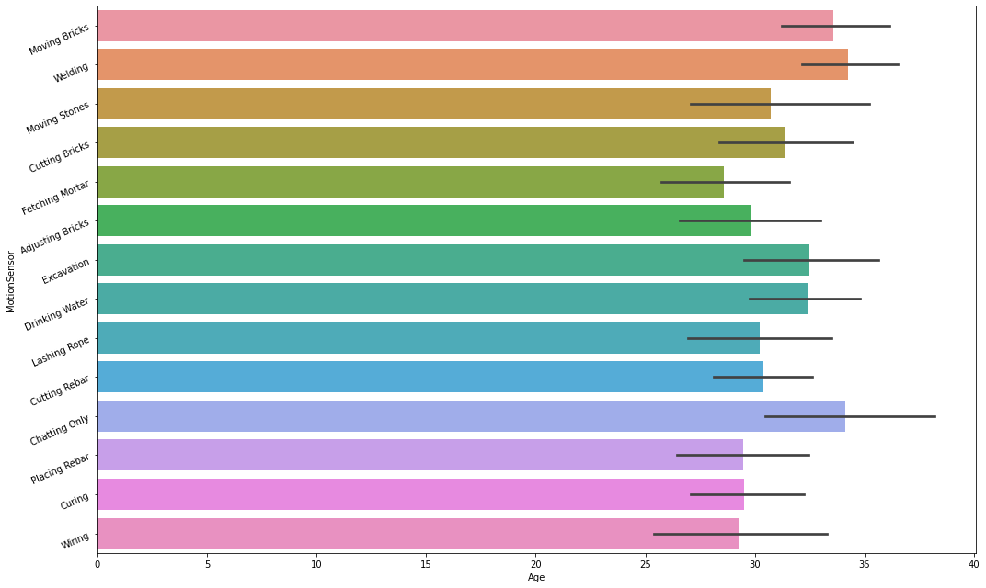
Data Visualization
Notes:
Piee

Slide 21
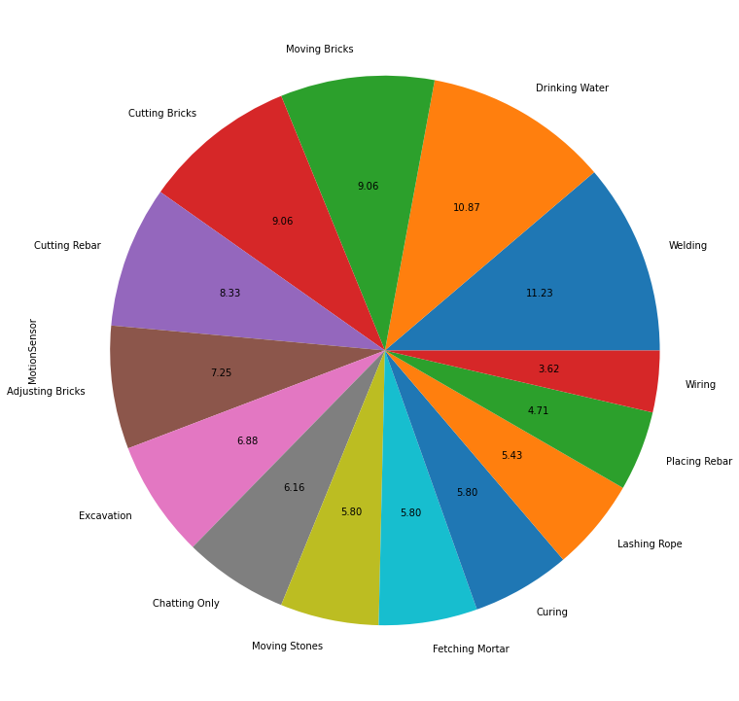
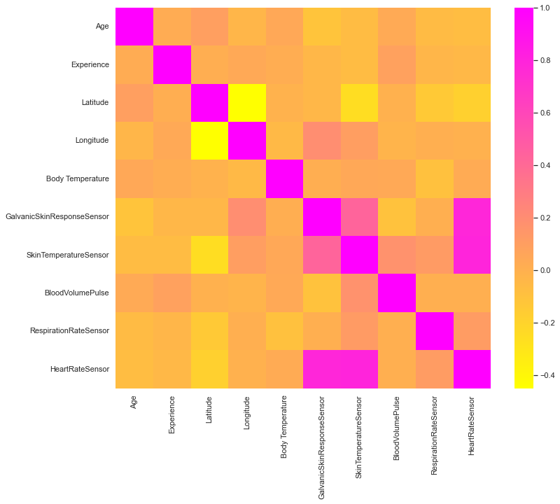
Data Visualization
Notes:
Piee

Slide 22
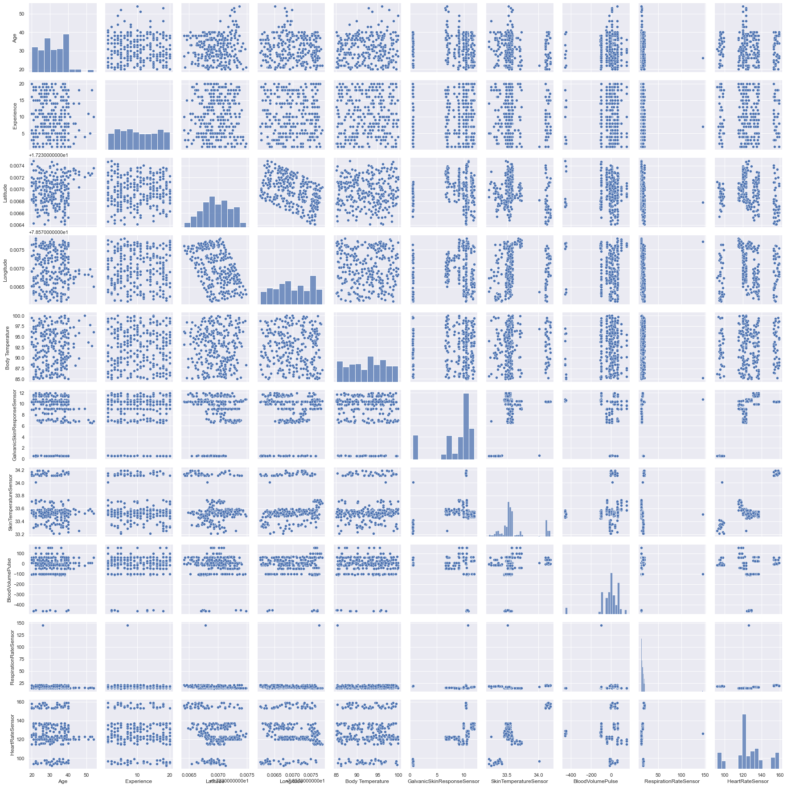
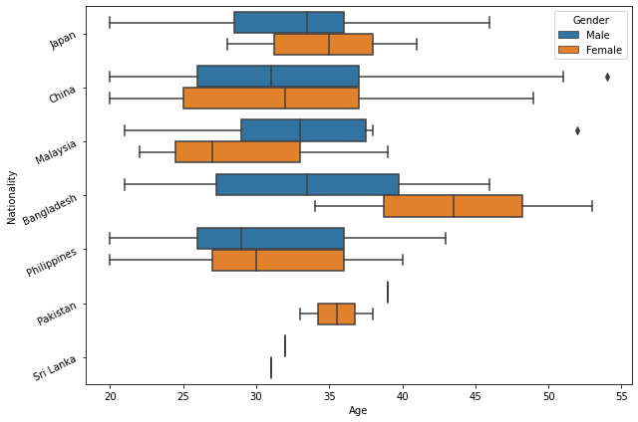
Data Visualization
Notes:
Piee

Slide 23
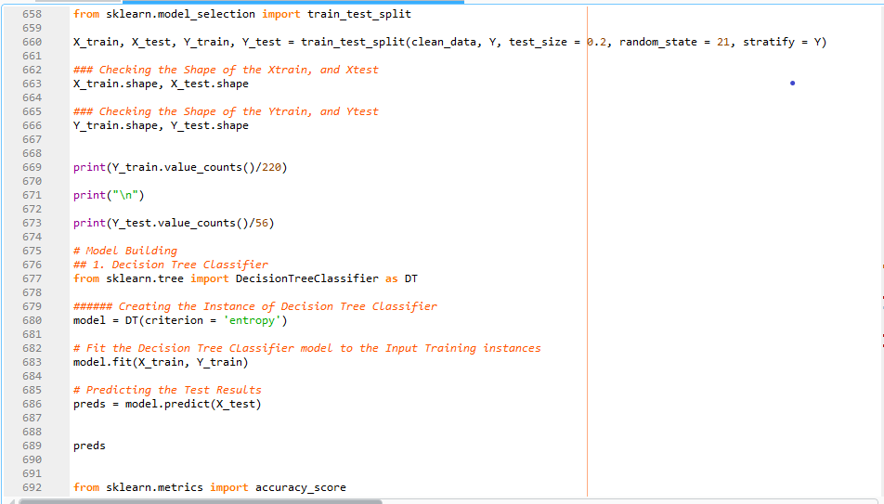
Model Building
We Build the model by using Different Algorithms to get better Accuracy score
Models are build using Python
Model build in different algorithms such as Decision Tree & its Hyper Parameter GridSearchCV, K-Nearest Neighbours Classifier, Logistic Regression, Support Vector Classifier, Random Forest Classifier
Notes:
classification is the task of predicting a discrete class label. Regression is the task of predicting a continuous quantity.
What is classification techniques in machine learning?
The Classification algorithm is a Supervised Learning technique that is used to identify the category of new observations on the basis of training data. In Classification, a program learns from the given dataset or observations and then classifies new observation into several classes or groups.
What is regression techniques in machine learning?
Regression is a technique for investigating the relationship between independent variables or features and a dependent variable or outcome. It's used as a method for predictive modeling in machine learning, in which an algorithm is used to predict continuous outcomes.

Slide 24
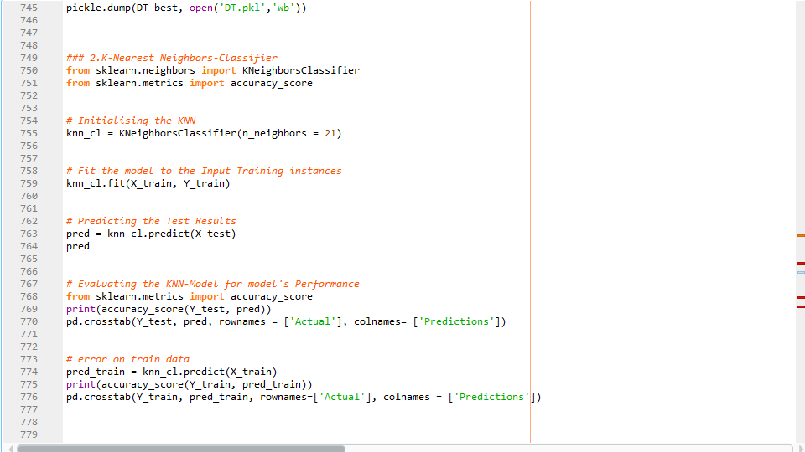
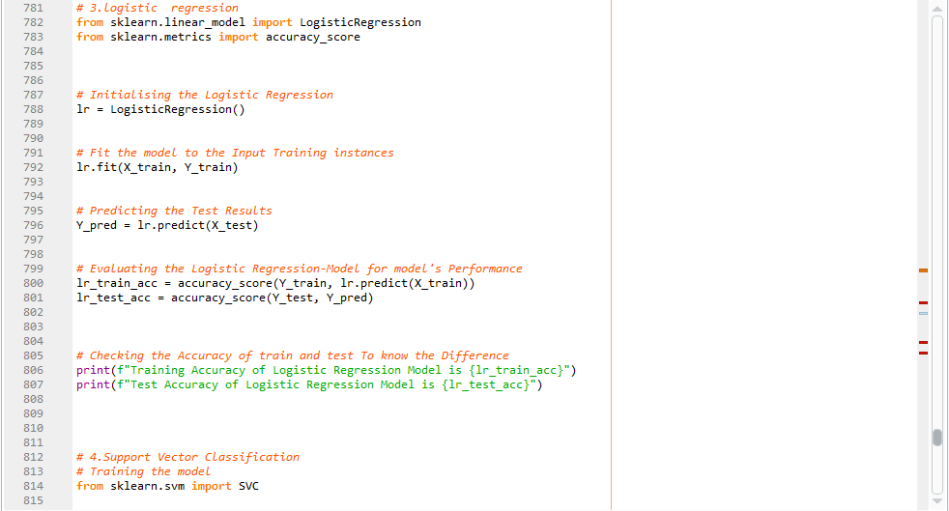
Model Building –

Slide 25
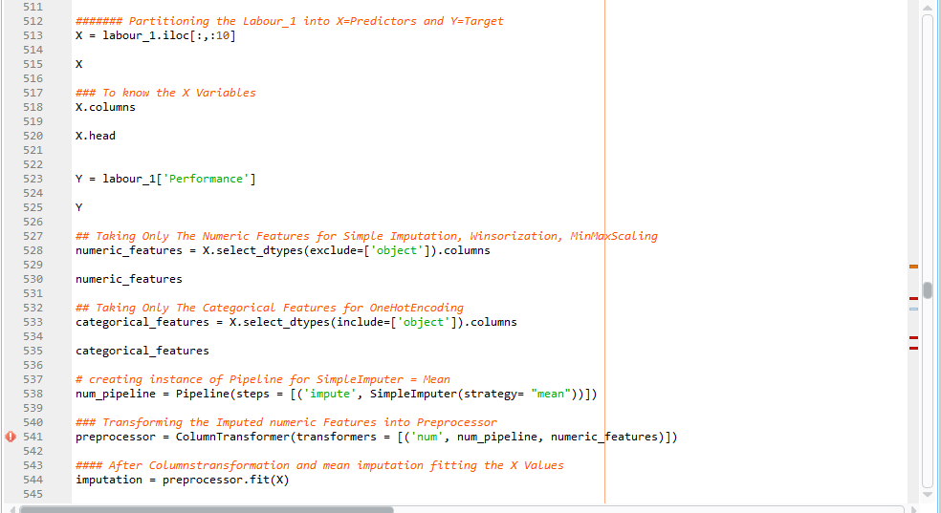
Model Building : –

Slide 26
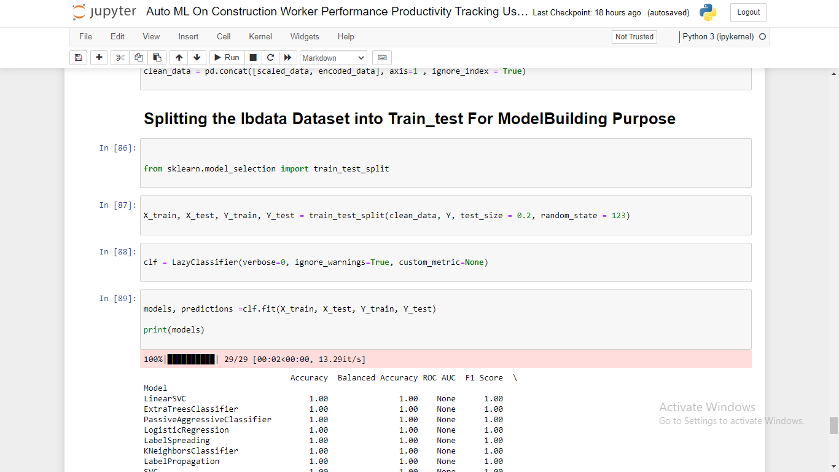
Auto ML Model Building Using LazyPredict Library: –

Slide 27
Model Accuracy Comparison
 | MODEL ACCURACY SCORE COMPARISON
 | MODEL | TRAIN SCORE | TEST SCORE | REMARKS
1. | Decision Tree Classifier | 1.0 | 1.0
2. | K Nearest Neighbor Classifier | 0.8954 | 0.875
3. | Logistic Regression | 0.9909 | 0.9821
4. | Support Vector Classifier | 1.0 | 1.0
5. | Random Forest Classifier | 0.9909 | 0.9821

Slide 28





Model Deployment - Strategy
We deployed our model in Python flask by Using Spyder tool
Flask app was used for building the web app deployment
It makes us easy to predict the result
Easy to Deploy & Predict
The necessary files for deployment are
Flask app
App.py
Index html
data.html
pickle file
Joblib file
Model.py files

Slide 29
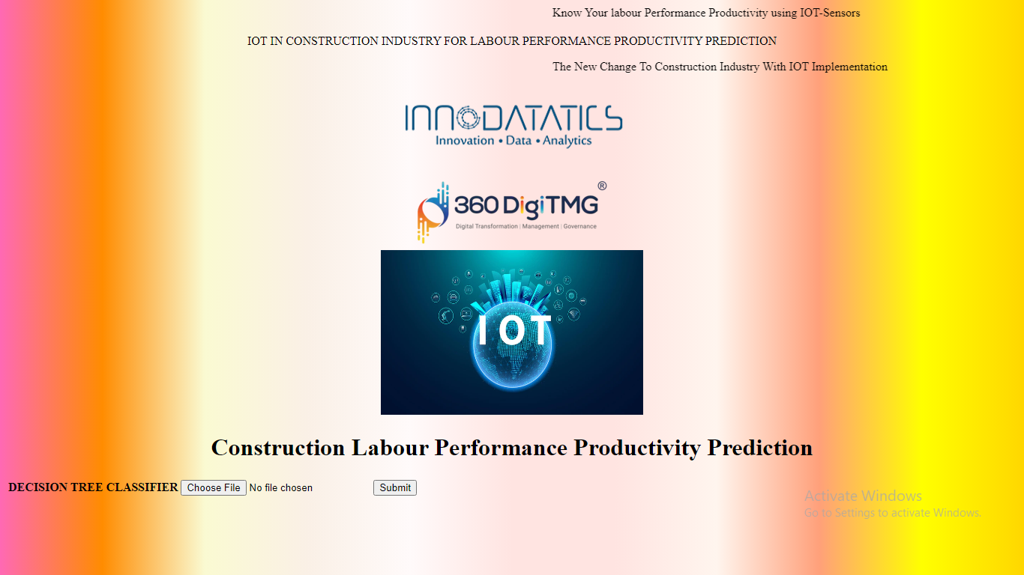
Screenshot of deployment

Slide 30
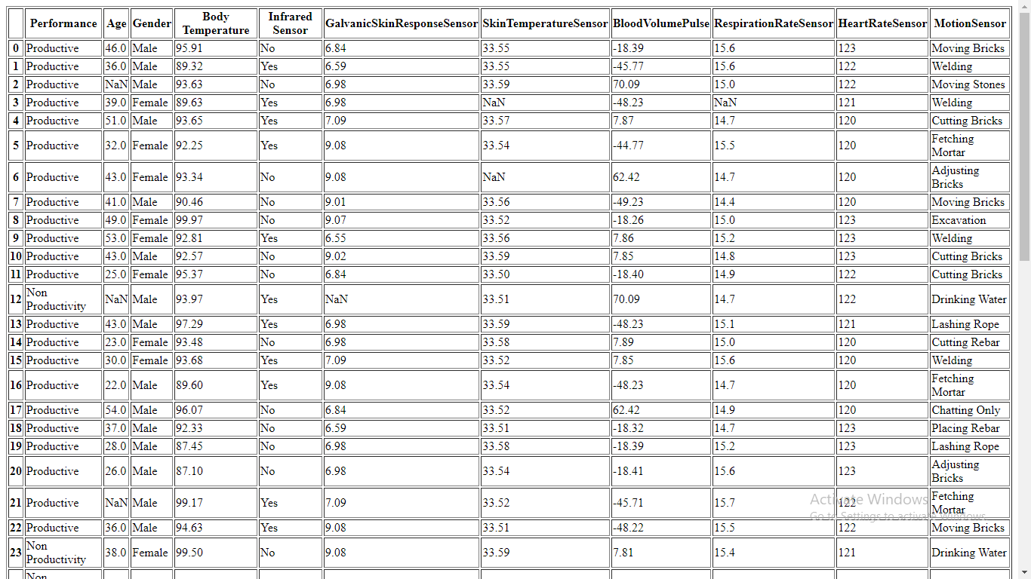
Screen shot of output

Slide 31

Challenges
The most challenging part of this project was data collection.
While collecting data, I explored so much of information, contacted people from construction industry, searched for many sources and collected information about iot sensors.
Next challenging thing was deployment of model. It was very tricky but interesting part during the project.

Slide 32
Future Scopes
IOT-Technology can be used to locate not only the workers on the job site but also to keep them Out of the danger zone.
This can be used to Create a real-time map of the construction site so that everyone knows who’s where and what work is being done.
Monitoring and Tracking the labours in their work area is very useful and important to complete the project in time within given period of Time.
Security and safety are two of the most challenging issues to deal with on a construction site.
Advantages:-
Control and Automation, Real-Time Access to Information, Cost Reduction,
Improve the Quality of Life, Higher Productivity, Health and Safety.

Slide 33

Queries ?

Slide 34


